Slide 1
GAS TRANSPORT
DR.TANIA WARNAKULASURIYA
DEPARTMENT OF PHYSIOLOGY

Slide 2
GAS TRANSPORT
O₂ and CO₂ transport depend on diffusion of gas and flow of blood.
Presence of Hb in blood increases O₂ carrying capacity in blood by 30-100 times.
Chemical reactions of CO₂ increases its transport by 17 times.

Slide 3
Transport of O₂ in blood.
Po₂
Alveolar -104 mmHg
Pulmonary capillary - 40 mmHg
Po₂ in pulmonary capillary rise to almost alveolar Po₂ 1/3 of the way through the pulmonary capillaries
(gas diffusion)
2% of shunt occurs in Left Atrium.
Po₂ Aorta – 95 mmHg

Slide 4
Transport of O₂ in blood.
Tissue Po₂ is determined by
Rate of blood flow
The rate O₂ is consumed by the tissues
Arterial Po₂ – 95mmHg
Interstitial fluid Po₂– 40mmhg
Intracellular Po₂ – 23mmHg
Venous Po₂ - 40mmHg

Slide 5
Transport of O₂ in blood.
20ml of O₂ is transported in 100 ml of blood in basal conditions.
5ml of O₂ per dL of blood is extracted at tissue level
97% of O₂ is transported in combination with Hb.
Only 0.3ml is dissolved
At high Po₂ - O₂ bind to Hb
At low Po₂ - O₂ released from Hb

Slide 6
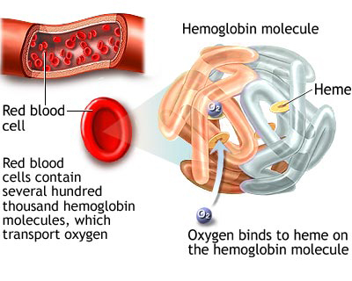
Hb in oxygen transport
When fully saturated each gram of Hb contain 1.39ml of O₂
IN A HEALTHY ADULT
 | Arterial blood | Venous blood
Hb saturation | 97% | 75%
Po₂ | 95mmHg | 40mmHg
O₂ content (mL/dL) | Dissolved -0.29 Combined – 19.5 | Dissolved -0.12 Combined – 15.1

Slide 7
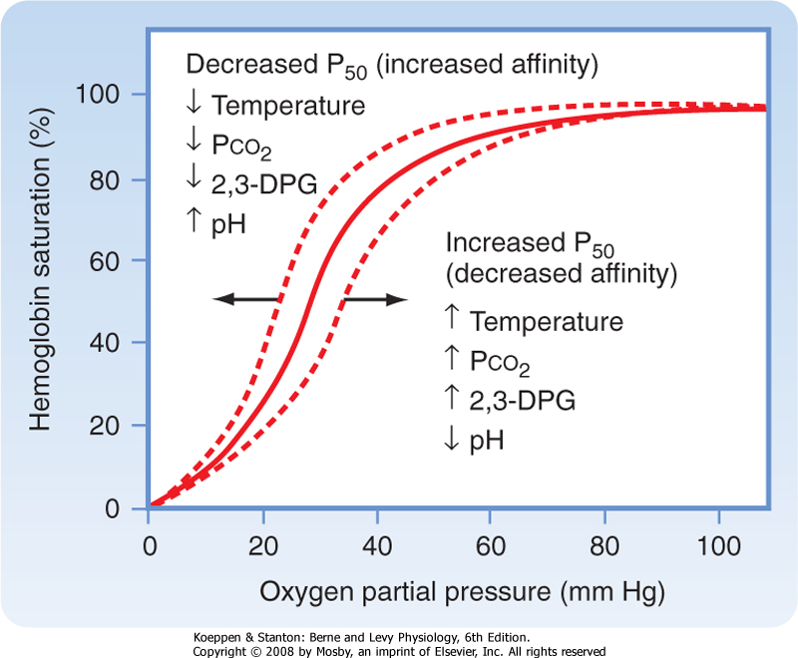
O₂ Hb dissociation curve
pH 7.4
Temp 37ºC
Pco₂ 40mmHg
Curve fascilitates
O₂ loading at lungs and
O₂ unloading at tissues
Curve is due to the cooperative binding of Hb molecule

Slide 8
O₂ Hb dissociation curve- at standard conditions
 | Po₂ (mmHg) | % sat Hb
Origin | 0 | 0
 | 27 | 50
 | 40 | 75
 | 100 | 98
Significance of the shape –
At high Po₂ values large changes in Po₂ occur with out significant alterations in Hb saturation
At lungs blood will be fully saturated even when Po₂ drop as low as 60mmHg
In tissues O₂ is released from blood with small changes in Po_{2 .}

Slide 9
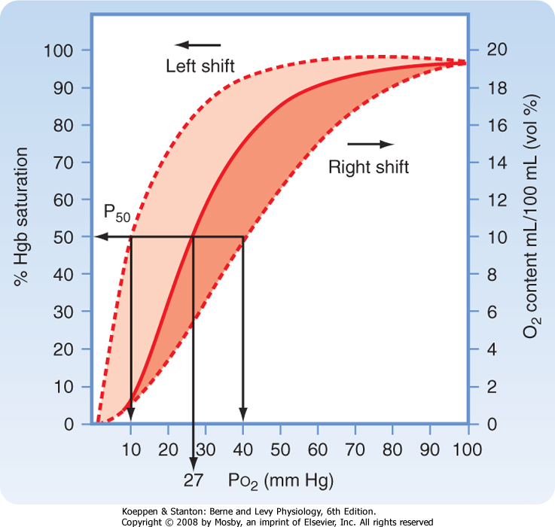
O₂ sturation and O₂ content in blood

Slide 10
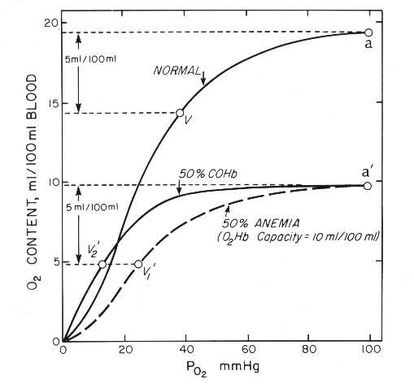
Vertical height reduce when amount of Hb is less
(eg anemia)
Change in the shape indicate change in the amount and affinity of Hb
(eg CO poisoning)

Slide 11
Transport of O₂ in blood.
Bohr effect
Decrease in O₂ affinity to Hb when the blood pH falls.
Helps in release of O₂ at tissues.

Slide 12
Transport of O₂ in blood.
Reverse happens at the lungs
Release of CO₂ H⁺ pH
Left Shift of O₂ – Hb dissociation curve
Increase uptake of O₂ by Hb

Slide 13
Transport of O₂ in blood.
During exercise
Temperature
CO₂
2,3 – DPG
Right shift of the O₂ – Hb dissociation curve
More O₂ released at the tissues
Increase in tissues

Slide 14
Transport of O₂ in blood.
Only 1.3 mmHg of O₂ pressure is needed to fully support the chemical processes with in the cells.
When intracellular Po₂ is >1mmHg the oxygen availability is not a limiting factor.

Slide 15
Transport of O₂ in blood.
Po₂ in the cell depend on
Rate of blood flow
The rate of O₂ consumed by the tissue
Distance between the cell and capillary
Normal intracellular Po₂ range from 5-40mmHg

Slide 16
Tissue metabolism of O₂
O₂ is metabolised in the cells and CO₂ is produced
Major determinant of blood pH

Slide 17
Transport of CO₂ in blood.
Intracellular P_{CO2} - 46mmHg
Interstitial P_{CO2} - 45 mmHg
Venous P_{CO2} - 45mmHg
Arterial P_{CO2} - 40mmHg

Slide 18
Transport of CO₂ in blood.
Solubility of CO₂ is x20 that of O₂
High solubility of CO₂ causes diffusion of CO₂ at a partial Pressure difference of only 1mmHg

Slide 19
Transport of CO₂ in blood.
4ml of CO₂ is transported in 100ml of blood
70% as bicarbonate ions
20% as carbamino compounds
7% dissolved in plasma

Slide 20
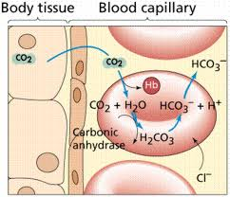
Transport of CO₂ in blood.

Slide 21
Carbonic anhydrase
Present in
red cells
Pulmonary capillary endothelial cells
H⁺ is buffered by Hb
HCO₃⁻ is exchanged for Cl⁻ via protein Band 3
(Cl⁻ shift)
Cl⁻ is osmotically active
In tissues - red cell swell
In lungs – red cell shrink

Slide 22
Transport of CO₂ in blood.
HALDANE EFFECT
Binding of O₂ with Hb releases CO_{2.}
Deoxygenated Hb binds more CO₂ and form carbamino compounds than oxy-haemoglobin.
More CO₂ is carried in venous blood.

Slide 23
Transport of CO₂ in blood.
Assignment
Describe thg HALDANE EFFECT and why it happens.
Hand over answers by Monday.
Venous P_{CO2} - 46mmHg
Alveolar P_{CO2} - 40mmHg
Arterial P_{CO2} - 40mmHg

Slide 24
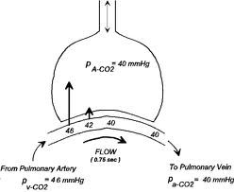
Transport of CO₂ in blood.

